Slide 1
Loan Underwriting and Repayment
Summer Project

Slide 2
Introduction
Loan ?
A loan is money, property or other material goods that are given to another party in exchange for future repayment of the loan value along with interest or other finance charges.
Who are underwriters ?
Underwriters assess the borrower's ability to repay the loan based on an analysis of their credit, capacity, and collateral.
Issues with Loan Repayment ?
A well-established bank approves 4-5 lakh loans every year, the number of application could be even higher, hence as far as the process of underwriting is concerned, the lending institution needs to be careful with the proceedings to minimize losses.

Slide 3
Introduction
Loan Underwriting ?
Loan underwriting is the process that we undertake to analyze all of the information provided by each loan applicant and their credit file to assess whether or not that applicant meets our minimum loan criteria.
Our System !
Our system evaluates the current status of the loan and the financial position of the borrower and renders a programmatic loan decision regarding whether the loan will be repaid as expected during approval, the goal is to get this done without human intervention.

Slide 4
Motivation
11 out of the 21 public sector banks in India are already under the banking regulation supervision of RBI’s Prompt Corrective Measure due to bad loan decisions
Shortcomings with Human Intervention in Loan Approvals ?
The necessity of human intervention cannot be ignored in some subjective decisions, but it also opens the decision to bias, inaccuracy and delay, which we want to be reducing at all costs.
Increased Number of Application for Loan.
The low interest rates of the last two years unleashed a substantial increase in loan applicants, This increase has led to a serious shortage of qualified underwriters.

Slide 5
Problem Definition
The two most critical questions in the lending industry are:
1) How risky is the borrower?
2) Given the borrower’s risk, should we lend him/her?
The answer to the first question determines the interest rate the borrower would have.
We’ll address the second question indirectly by trying to predict if the borrower will repay the loan by its mature date or not. Thus ensuring if the borrower will be able to pay off the loan or not.

Slide 6
Ensemble Method
Ensemble method was undertaken by us to accurately predict whether the borrower will be able to repay the loan by its mature date or not.
They can be defined as combining several different models (base learners) into final model (meta learner) to reduce the generalization error. It relies on the assumption that each model would look at a different aspect of the data which yield to capturing part of the truth, thus improving over the performance of the base learners.
We have used the Random Forest Classifier, Support VEctor CLassifier and Gradient Boosting for designing the Model.

Slide 7
Random forest Classifier
Random forest classifier creates a set of decision trees from randomly selected subset of training set.
It then aggregates the votes from different decision trees to decide the final class of the test object.
A random forest is a meta estimator that fits a number of decision tree classifiers on various sub-samples of the dataset and use averaging to improve the predictive accuracy and control over-fitting.

Slide 8
Gradient Boosting
Gradient boosting is a machine learning technique for regression and classification problems, which produces a prediction model in the form of an ensemble of weak prediction models, typically decision trees.
It builds the model in a stage-wise fashion like other boosting methods do, and it generalizes them by allowing optimization of an arbitrary differentiable loss function.
Gradient Boosting is a glorified gradient descent algorithm consisting of weak models as steps towards optimization instead of data points.

Slide 9
Support Vector Classifier
In machine learning, support vector machines are supervised learning models with associated learning algorithms that analyze data used for classification and regression analysis.
An SVM model is a representation of the examples as points in space, mapped so that the examples of the separate categories are divided by a clear gap that is as wide as possible.
New examples are then mapped into that same space and predicted to belong to a category based on which side of the gap they fall.

Slide 10
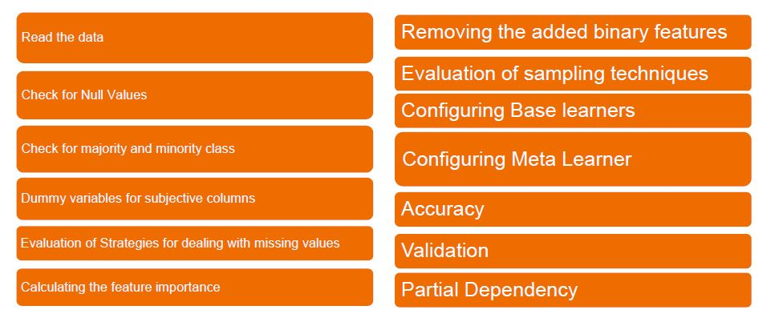
Flow Chart Depicting the Flow of the Model

Slide 11
Parameters Used
Purpose
Revol_balance
Inq_last_6mths
Deling_2yrs
Pub_rec
Annual_inc
Int_rate
Installment
Dti
Revol_util
Loan_status
Emp_status
Real_estate_ownership

Slide 12
Strategies to deal with missing values :-
Simply delete all examples that have any missing values.
Impute the missing values using the mean of each feature separately.
Impute the missing values using the median of each feature separately.

Slide 13
Strategies to deal with imbalanced datasets :-
Under-Sample: Under-sample the majority class with or without replacement by making the number of positive and negative examples equal.
Over-Sample: Over-sample the minority class with or without replacement by making the number of positive and negative examples equal.
EasyEnsemble: Sample several subsets from the majority class, build a classifier on top of each sampled data, and combine the output of all classifiers.
Synthetic Minority Oversampling Technique (SMOTE): It over-samples the minority class but using synthesized examples. It operates on feature space not the data space.

Slide 14
Modelling
Ensemble methods can be defined as combining several different models (base learners) into final model (meta learner) to reduce the generalization error.
Almost always ensemble model performance gets improved as we add more models.
We try to combine models that are as much different as possible. This will reduce the correlation between the models that will improve the performance of the ensemble model.

Slide 15
Ensemble Modelling Techniques
Blending: Averaging the predictions of all models.
Bagging: Build different models on different datasets and then take the majority vote from all the models.
Boosting: Build models sequentially. That means each model learns from the residuals of the previous model. The output will be all output of each single model weighted by the learning rate λ. It reduces the bias resulted from bagging by learning sequentially from residuals of previous trees (models).
Stacking: Build k models called base learners. Then fit a model to the output of the base learners to predict the final output.

Slide 16
Data Preprocessing
Create dummy variables from the feature “purpose” since its nominal (not ordinal) categorical variable.
Split the data into training set (70%), and test set (30%). Training set will be used to fit the model, and test set will be to evaluate the best model to get an estimation of generalization error.
Standardize the data. We’ll be using RobustScaler so that the standardization will be less influenced by the outliers, i.e. more robust.

Slide 17
Base Learners
Gradient Boosting
Support Vector Classifier
Random Forest

Slide 18
Ensemble Models
Blending (average) ensemble model. Fits the base learners to the training data and then, at test time, average the predictions generated by all the base learners.
Stacked ensemble model: Fits the base learners to the training data. Next, use those trained base learners to generate predictions (meta-features) used by the meta-learner (assuming we have only one layer of base learners).

Slide 19
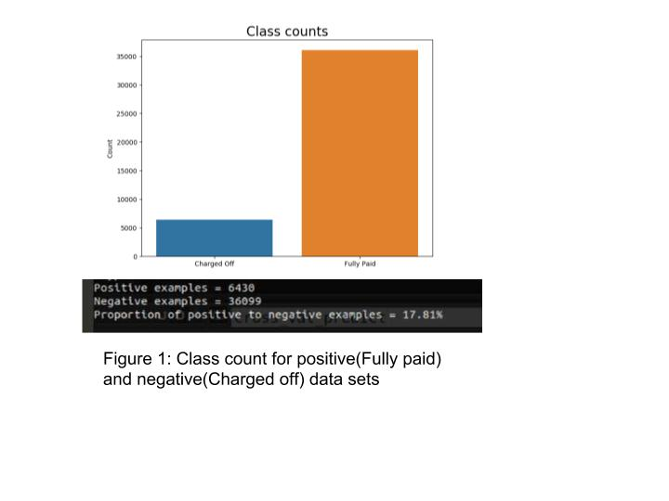
Results

Slide 20
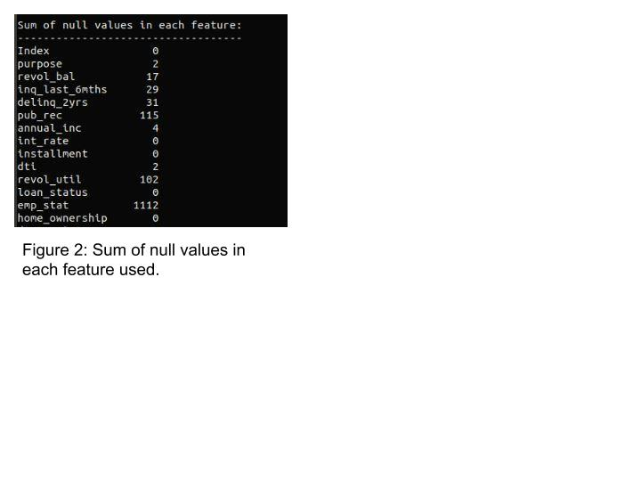
Results

Slide 21
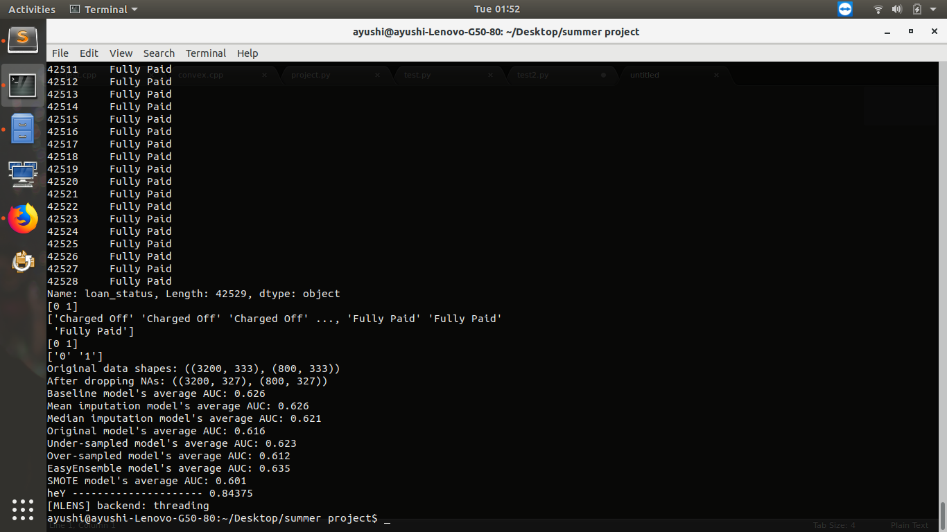
Results : dealing with missing values

Slide 22
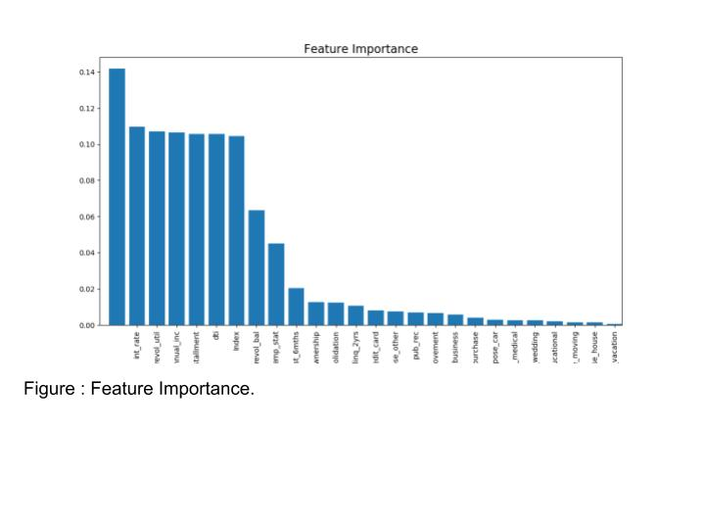
Results

Slide 23
Results : dealing with imbalanced data

Slide 24
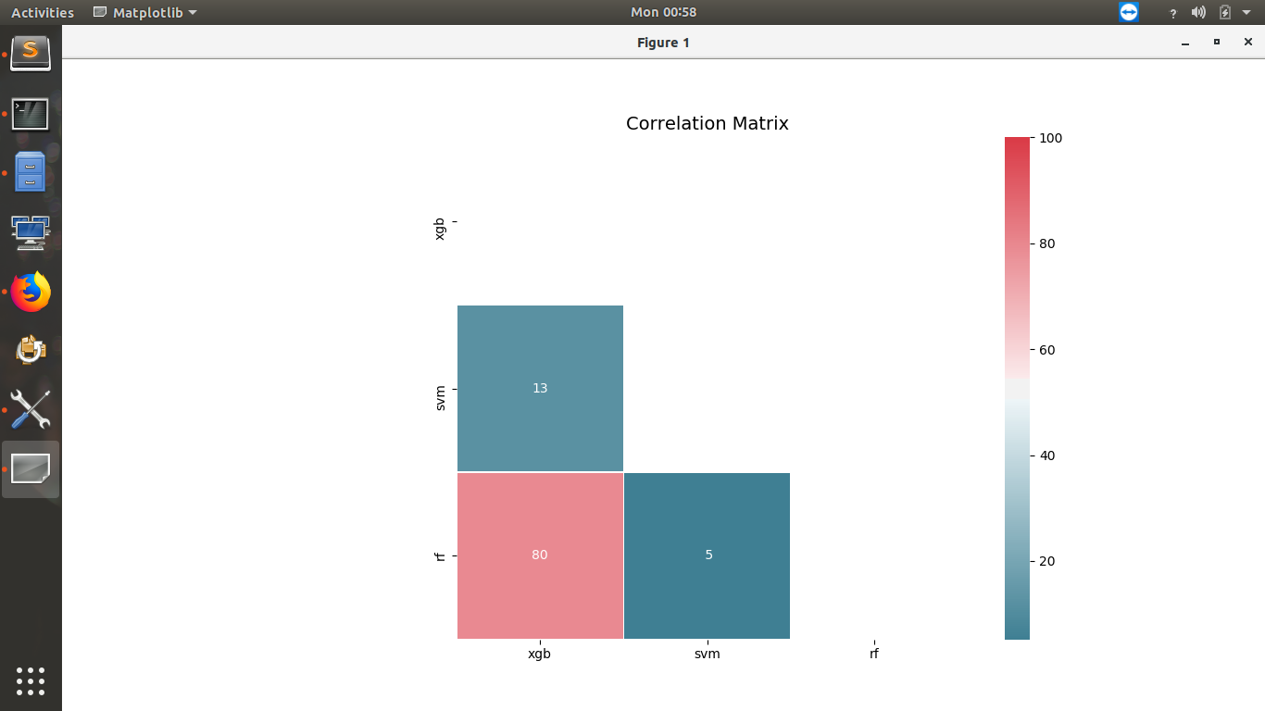
Results

Slide 25
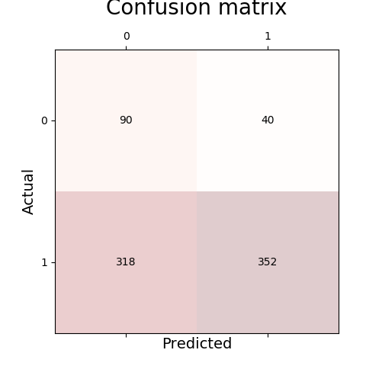
Results

Slide 26
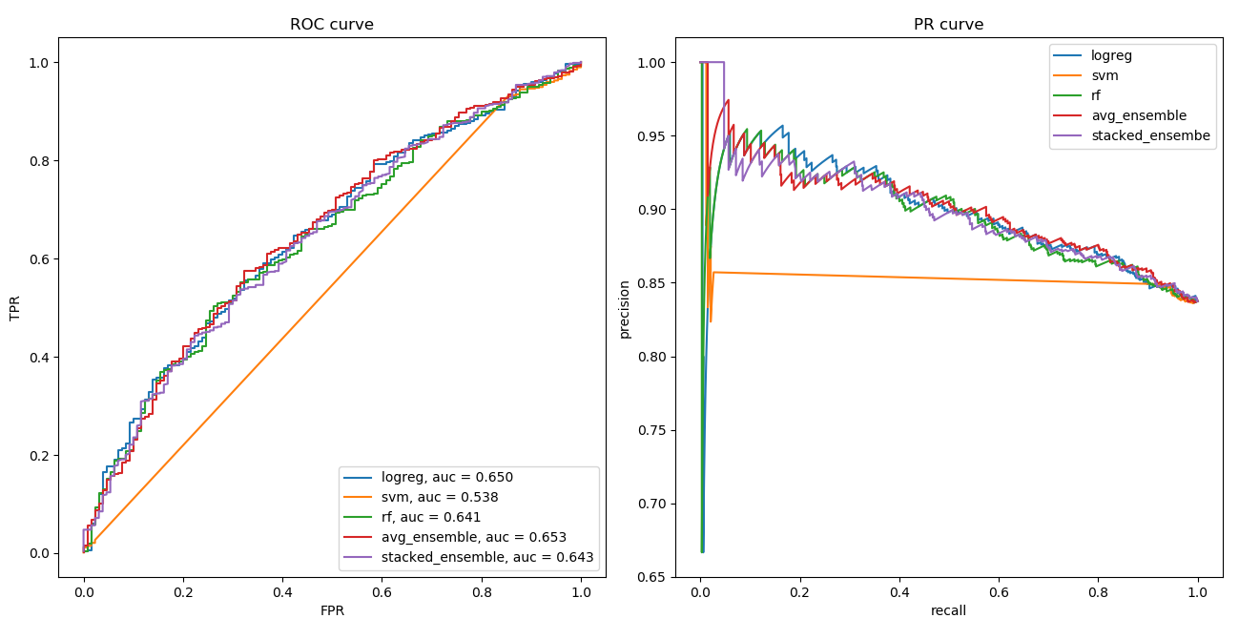
Results

Slide 27
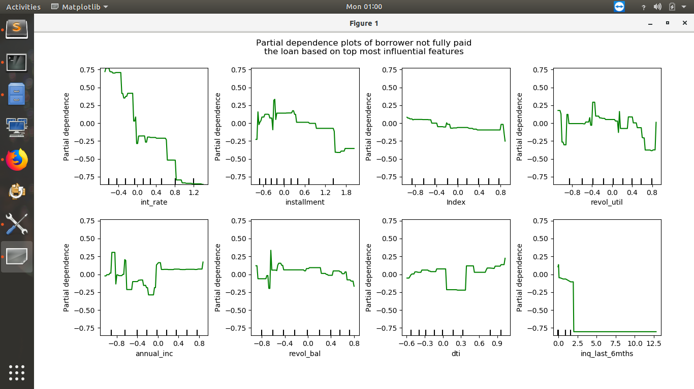
Results

Slide 28
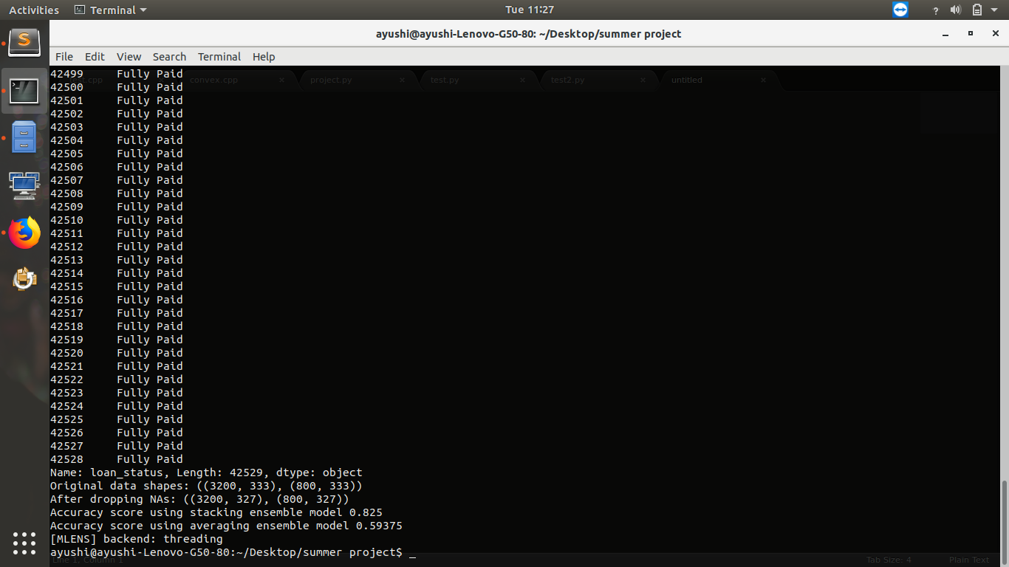
Results

Slide 29
Conclusion
EasyEnsemble usually performs better than any other resampling methods.
Sometimes we may be willing to give up some improvement to the model if that would increase the complexity much more than the percentage change in the evaluation metrics.
Complicated sampling like SMOTE or EasyEnsemble significantly increased the complexity of the program while causing as little as a 2% increase in accuracy.
Missing values sometimes add more information to the model than we might expect. One way of capturing it is to add binary features for each feature that has missing values to check if each example is missing or not.

Slide 30
Conclusion
In some classification problems, False Positive are a lot more expensive than False Negatives or vice versa. Therefore, we can reduce cut-off points to reduce the False Positives.
For a specific set of loan types, relatively simpler models also gave significantly accurate results, therefore there is not definitive rule of thumb to select a suitable model/ set of models.
When building ensemble models, we try to use good models that are as different as possible to reduce correlation between the base learners.

Slide 31
Submitted by
Mudit Rathore (ICM2015502)
Ayushi Asthana (ITM2015004)
Ishani Mishra (IWM2015008)

Slide 32
Thank You

